Slide 1
Database Systems
Lecture 2-Chapter # 7
More SQL: Complex Queries, Triggers, Views, and Schema Modification
Alina Arshad
alina.arshad@nu.edu.pk

Slide 2
Grouping: The GROUP BY and HAVING Clauses
GROUP BY: specifies the grouping attributes
For example, find the average salary of employees in each department or the number of employees who work on each project.
Grouping attributes must appear in the SELECT clause, so that the value resulting from applying each aggregate function to a group of tuples appears along with the value of the grouping attribute(s).
Notes:
In many cases we want to apply the aggregate functions to subgroups of tuples in a relation, where the subgroups are based on some attribute values. For example, we may want to find the average salary of employees in each department or the number of employees who work on each project. In these cases we need to partition the relation into non-overlapping subsets (or groups) of tuples. Each group (partition) will consist of the tuples that have the same value of some attribute(s), called the grouping attribute(s).
We can then apply the function to each such group independently to produce summary information about each group. SQL has a GROUP BY clause for this purpose. The GROUP BY clause specifies the grouping attributes, which should also appear in the SELECT clause, so that the value resulting from applying each aggregate function to a group of tuples appears along with the value of the grouping attribute(s).

Slide 3
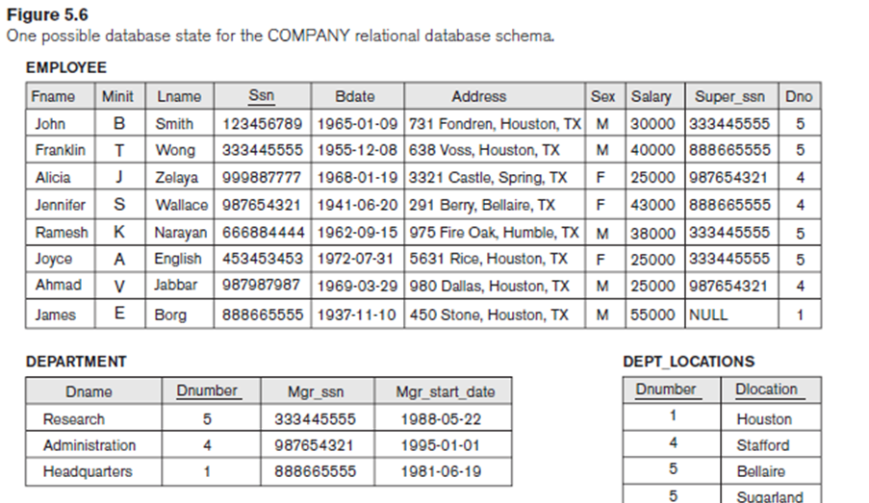
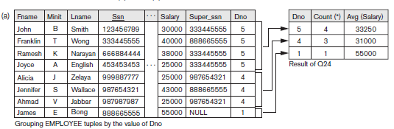
Query 24. For each department, retrieve the department number, the number of employees in the department, and their average salary.
Q24: SELECT Dno, COUNT (*), AVG (Salary)
FROM EMPLOYEE
GROUP BY Dno;
Notes:
If the grouping attribute has NULL as a possible value, then a separate group is created for the null value (e.g., null Dno in the above query)

Slide 4
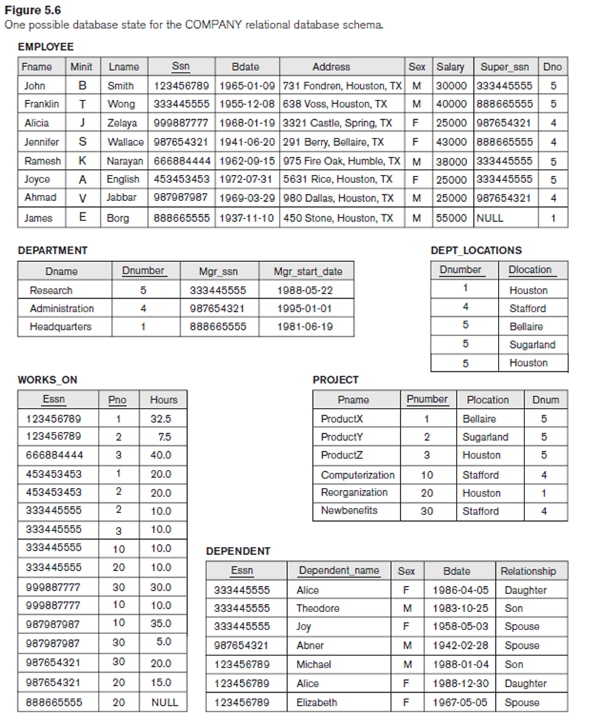
Query 25. For each project, retrieve the project number, the project name, and the number of employees who work on that project.
SELECT Pnumber, Pname, COUNT (*)
FROM PROJECT, WORKS_ON
WHERE Pnumber = Pno
GROUP BY Pnumber, Pname;
Notes:
Q25: SELECT Pnumber, Pname, COUNT (*)
FROM PROJECT, WORKS_ON
WHERE Pnumber = Pno
GROUP BY Pnumber, Pname;

Slide 5
HAVING clause
HAVING : Provides a condition to select or reject an entire group:
Only the groups that satisfy the condition are retrieved in the result of the query.

Slide 6
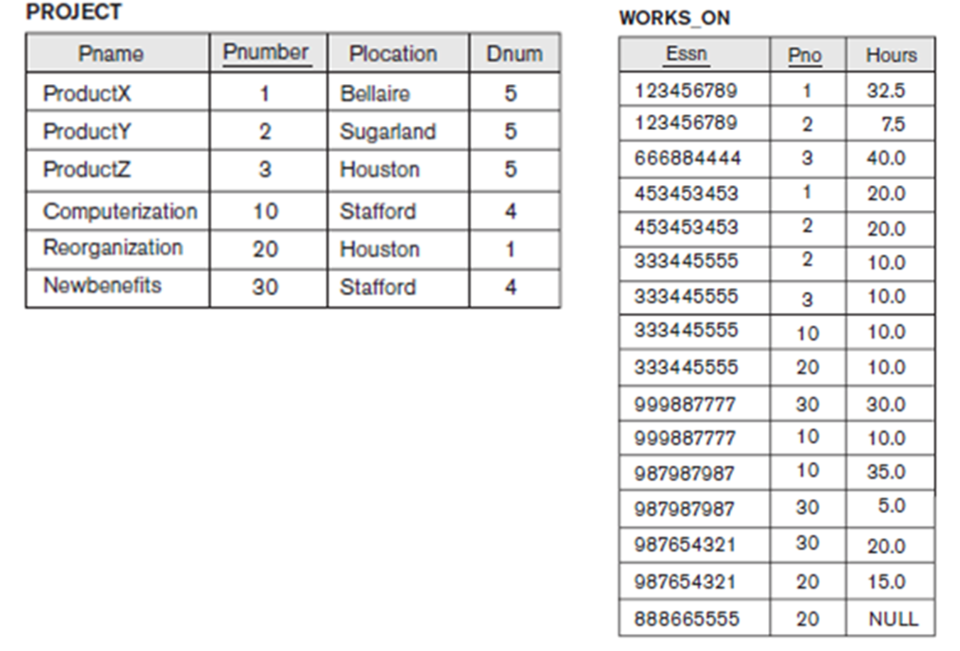
Query 26. For each project on which more than two employees work, retrieve the project number, the project name, and the number of employees who work on the project.
Q26: SELECT Pnumber, Pname, COUNT (*)
FROM PROJECT, WORKS_ON
WHERE Pnumber = Pno
GROUP BY Pnumber, Pname
HAVING COUNT (*) > 2;
Notes:
Q26: SELECT Pnumber, Pname, COUNT (*)
FROM PROJECT, WORKS_ON
WHERE Pnumber = Pno
GROUP BY Pnumber, Pname
HAVING COUNT (*) > 2;

Slide 7
Query 27. For each project, retrieve the project number, the project name, and the number of employees from department 5 who work on the project.
Q27: SELECT Pnumber, Pname, COUNT (*)
FROM PROJECT, WORKS_ON, EMPLOYEE
WHERE Pnumber = Pno AND Ssn = Essn AND Dno = 5
GROUP BY Pnumber, Pname;
Notes:
Q27: SELECT Pnumber, Pname, COUNT (*)
FROM PROJECT, WORKS_ON, EMPLOYEE
WHERE Pnumber = Pno AND Ssn = Essn AND Dno = 5
GROUP BY Pnumber, Pname;

Slide 8
Combining the WHERE and the HAVING Clause
Consider the query: we want to count the total number of employees whose salaries exceed $40,000 in each department, but only for departments where more than five employees work.
Notes:
SELECT Dno, COUNT (*)
FROM EMPLOYEE
WHERE Salary>40000
GROUP BY Dno
HAVING COUNT (*) > 5;
This is incorrect because it will select only departments that have more than five
employees who each earn more than $40,000. The rule is that the WHERE clause is
executed first, to select individual tuples or joined tuples; the HAVING clause is
applied later, to select individual groups of tuples. In the incorrect query, the tuples
are already restricted to employees who earn more than $40,000 before the function
in the HAVING clause is applied. One way to write this query correctly is to use a
nested query, as shown in Query 28.

Slide 9
Query 28. For each department that has more than five employees, retrieve the department number and the number of its employees who are making more than $40,000.
Q28: SELECT Dno, COUNT (*)
FROM EMPLOYEE
WHERE Salary>40000 AND Dno IN
( SELECT Dno
FROM EMPLOYEE
GROUP BY Dno
HAVING COUNT (*) > 5)
GROUP BY Dno;
Note: the WHERE clause applies tuple by tuple whereas HAVING applies to entire group of tuples
Notes:
Q28: SELECT Dno, COUNT (*)
FROM EMPLOYEE
WHERE Salary>40000 AND Dno IN
( SELECT Dno
FROM EMPLOYEE
GROUP BY Dno
HAVING COUNT (*) > 5)
GROUP BY Dno;

Slide 10
EXPANDED Block Structure of SQL Queries
SELECT <attribute and function list>
FROM <table list>
[ WHERE <condition> ]
[ GROUP BY <grouping attribute(s)> ]
[ HAVING <group condition> ]
[ ORDER BY <attribute list> ];
Notes:
The SELECT clause lists the attributes or functions to be retrieved. The FROM clause specifies all relations (tables) needed in the query, including joined relations, but not those in nested queries. The WHERE clause specifies the conditions for selecting the tuples from these relations, including join conditions if needed. GROUP BY specifies grouping attributes, whereas HAVING specifies a condition on the groups being selected rather than on the individual tuples. The built-in aggregate functions COUNT, SUM, MIN, MAX, and AVG are used in conjunction with grouping, but they can also be applied to all the selected tuples in a query without a GROUP BY clause.
Finally, ORDER BY specifies an order for displaying the result of a query.
In order to formulate queries correctly, it is useful to consider the steps that define the meaning or semantics of each query. A query is evaluated conceptually by first applying the FROM clause (to identify all tables involved in the query or to materialize any joined tables), followed by the WHERE clause to select and join tuples, and then by GROUP BY and HAVING. Conceptually, ORDER BY is applied at the end to sort the query result. If none of the last three clauses (GROUP BY, HAVING, and ORDER BY) are specified, we can think conceptually of a query as being executed as follows: For each combination of tuples—one from each of the relations specified in the FROM clause—evaluate the WHERE clause; if it evaluates to TRUE, place the values of the attributes specified in the SELECT clause from this tuple combination in the result of the query.
Of course, this is not an efficient way to implement the query in a real system, and each DBMS has special query optimization routines to decide on an execution plan that is efficient to execute.
In general, there are numerous ways to specify the same query in SQL. This flexibility in specifying queries has advantages and disadvantages. The main advantage is that users can choose the technique with which they are most comfortable when specifying a query. For example, many queries may be specified with join conditions in the WHERE clause, or by using joined relations in the FROM clause, or with some form of nested queries and the IN comparison operator. Some users may be more comfortable with one approach, whereas others may be more comfortable with another. From the programmer’s and the system’s point of view regarding query optimization, it is generally preferable to write a query with as little nesting and implied ordering as possible.
The disadvantage of having numerous ways of specifying the same query is that this may confuse the user, who may not know which technique to use to specify particular types of queries.
Another problem is that it may be more efficient to execute a query specified in one way than the same query specified in an alternative way. Ideally, this should not be the case: The DBMS should process the same query in the same way regardless of how the query is specified. But this is quite difficult in practice, since each DBMS has different methods for processing queries specified in different ways.
Thus, an additional burden on the user is to determine which of the alternative specifications is the most efficient to execute. Ideally, the user should worry only about specifying the query correctly, whereas the DBMS would determine how to execute the query efficiently. In practice, however, it helps if the user is aware of which types of constructs in a query are more expensive
to process than others.

Slide 11
Views (Virtual Tables) in SQL
Virtual table : A view does not necessarily exist in physical form;
A single table that is derived from other tables
Other tables can be base tables or previously defined views.
Syntax:
CREATE VIEW view_name AS
SELECT column1, column2, ...
FROM table_name
WHERE condition;
Notes:
Concept of a View in SQL
A view in SQL terminology is a single table that is derived from other tables. These other tables can be base tables or previously defined views. A view does not necessarily exist in physical form; it is considered to be a virtual table, in contrast to base tables, whose tuples are always physically stored in the database. This limits the possible update operations that can be applied to views, but it does not provide any limitations on querying a view.
We can think of a view as a way of specifying a table that we need to reference frequently, even though it may not exist physically. For example, referring to the COMPANY database in Figure 5.5, we may frequently issue queries that retrieve the employee name and the project names that the employee works on. Rather than having to specify the join of the three tables EMPLOYEE, WORKS_ON, and PROJECT every time we issue this query, we can define a view that is specified as the result of these joins. Then we can issue queries on the view, which are specified as single table retrievals rather than as retrievals involving two joins on three tables. We call the EMPLOYEE, WORKS_ON, and PROJECT tables the defining tables of the view.

Slide 12
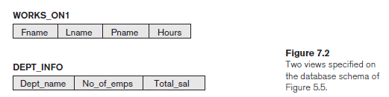
Specification of Views in SQL
VIEW WITH NO NEW ATTRIBUTES
V1: CREATE VIEW WORKS_ON1
AS SELECT Fname, Lname, Pname, Hours
FROM EMPLOYEE, PROJECT, WORKS_ON
WHERE Ssn = Essn AND Pno = Pnumber;
VIEW WITH NEW ATTRIBUTES
V2: CREATE VIEW DEPT_INFO(Dept_name, No_of_emps, Total_sal)
AS SELECT Dname, COUNT (*), SUM (Salary)
FROM DEPARTMENT, EMPLOYEE
WHERE Dnumber = Dno
GROUP BY Dname;
Notes:
Specification of Views in SQL
In SQL, the command to specify a view is CREATE VIEW. The view is given a (virtual) table name (or view name), a list of attribute names, and a query to specify the contents of the view. If none of the view attributes results from applying functions or arithmetic operations, we do not have to specify new attribute names for the view, since they would be the same as the names of the attributes of the defining tables in the default case.
The views in V1 and V2 create virtual tables whose schemas are illustrated in Figure 7.2 when applied to the database schema of Figure 5.5.
V1: CREATE VIEW WORKS_ON1
AS SELECT Fname, Lname, Pname, Hours
FROM EMPLOYEE, PROJECT, WORKS_ON
WHERE Ssn = Essn AND Pno = Pnumber;
V2: CREATE VIEW DEPT_INFO(Dept_name, No_of_emps, Total_sal)
AS SELECT Dname, COUNT (*), SUM (Salary)
FROM DEPARTMENT, EMPLOYEE
WHERE Dnumber = Dno
GROUP BY Dname;
In V1, we did not specify any new attribute names for the view WORKS_ON1(although we could have); in this case, WORKS_ON1 inherits the names of the view attributes from the defining tables EMPLOYEE, PROJECT, and WORKS_ON.
View V2 explicitly specifies new attribute names for the view DEPT_INFO, using a one-to-one correspondence between the attributes specified in the CREATE
VIEW clause and those specified in the SELECT clause of the query that defines the view.
We can now specify SQL queries on a view—or virtual table—in the same way we specify queries involving base tables. For example, to retrieve the last name and first name of all employees who work on the ‘ProductX’ project, we can utilize the WORKS_ON1 view and specify the query as in QV1:
QV1: SELECT Fname, Lname
FROM WORKS_ON1
WHERE Pname = ‘ProductX’;
The same query would require the specification of two joins if specified on the base relations directly; one of the main advantages of a view is to simplify the specification of certain queries.
Views are also used as a security and authorization mechanism
A view is supposed to be always up-to-date; if we modify the tuples in the base tables on which the view is defined, the view must automatically reflect these changes. Hence, the view does not have to be realized or materialized at the time of view definition but rather at the time when we specify a query on the view. It is the responsibility of the DBMS and not the user to make sure that the view is kept upto- date.
If we do not need a view anymore, we can use the DROP VIEW command to dispose of it. For example, to get rid of the view V1, we can use the SQL statement in V1A:
V1A: DROP VIEW WORKS_ON1;

Slide 13
Specification of Views in SQL
A view is always up-to-date: if the tuples are modified in the base tables on which the view is defined, the view must automatically reflect these changes.
DROP VIEW command:
Syntax:
DROP VIEW WORKS_ON1;
Notes:
A view is supposed to be always up-to-date; if we modify the tuples in the base tables on which the view is defined, the view must automatically reflect these changes. Hence, the view does not have to be realized or materialized at the time of view definition but rather at the time when we specify a query on the view. It is the responsibility of the DBMS and not the user to make sure that the view is kept upto- date.
If we do not need a view anymore, we can use the DROP VIEW command to dispose of it. For example, to get rid of the view V1, we can use the SQL statement in V1A:
V1A: DROP VIEW WORKS_ON1;

Slide 14
View Implementation, View Update, and Inline Views
Efficiently implement a view for efficient querying is complex. Two main approaches have been suggested.
Strategy # 1: (query modification) involves transforming the view query (submitted by the user) into a query on the underlying base tables.
For example, the query QV1 would be automatically modified to the following query by the DBMS:
* SELECT Fname, Lname
FROM WORKS_ON1
WHERE Pname = ‘ProductX’;
* SELECT Fname, Lname
FROM EMPLOYEE, PROJECT, WORKS_ON
WHERE Ssn = Essn AND Pno = Pnumber
AND Pname = ‘ProductX’;
Disadvantage of this approach: inefficient for views defined via complex queries that are time-consuming to execute
Notes:
View Implementation, View Update, and Inline Views
The problem of how a DBMS can efficiently implement a view for efficient querying is complex.
Two main approaches have been suggested.
One strategy, called query modification, involves modifying or transforming the view query (submitted by the user) into a query on the underlying base tables. For example, the query QV1 would be automatically modified to the following query by the DBMS:
SELECT Fname, Lname
FROM EMPLOYEE, PROJECT, WORKS_ON
WHERE Ssn = Essn AND Pno = Pnumber
AND Pname = ‘ProductX’;
The disadvantage of this approach is that it is inefficient for views defined via complex queries that are time-consuming to execute, especially if multiple view queries are going to be applied to the same view within a short period of time.
The second strategy, called view materialization, involves physically creating a temporary or permanent view table when the view is first queried or created and keeping that table on the assumption that other queries on the view will follow.
In this case, an efficient strategy for automatically updating the view table when the base tables are updated must be developed in order to keep the view up-to-date.
Techniques using the concept of incremental update have been developed for this purpose, where the DBMS can determine what new tuples must be inserted, deleted, or modified in a materialized view table when a database update is applied to one of the defining base tables. The view is generally kept as a materialized (physically stored) table as long as it is being queried. If the view is not queried for a certain period of time, the system may then automatically remove the physical table and recompute it from scratch when future queries reference the view.
Different strategies as to when a materialized view is updated are possible.
immediate update strategy updates a view as soon as the base tables are changed;
lazy update strategy updates the view when needed by a view query;
periodic update strategy updates the view periodically (in the latter strategy,
a view query may get a result that is not up-to-date).
A user can always issue a retrieval query against any view. However, issuing an INSERT, DELETE, or UPDATE command on a view table is in many cases not possible.
In general, an update on a view defined on a single table without any aggregate functions can be mapped to an update on the underlying base table under certain conditions.
For a view involving joins, an update operation may be mapped to update operations on the underlying base relations in multiple ways. Hence, it is often not possible for the DBMS to determine which of the updates is intended. To
illustrate potential problems with updating a view defined on multiple tables,
Consider the WORKS_ON1 view, and suppose that we issue the command to update the PNAME attribute of ‘John Smith’ from ‘ProductX’ to ‘ProductY’.
This view update is shown in UV1:
UV1: UPDATE WORKS_ON1
SET Pname = ‘ProductY’
WHERE Lname = ‘Smith’ AND Fname = ‘John’
AND Pname = ‘ProductX’;
This query can be mapped into several updates on the base relations to give the desired update effect on the view. In addition, some of these updates will create additional side effects that affect the result of other queries.
For example, here are two possible updates, (a) and (b), on the base relations corresponding to the view update operation in UV1:
(a): UPDATE WORKS_ON
SET Pno = ( SELECT Pnumber
FROM PROJECT
WHERE Pname = ‘ProductY’ )
WHERE Essn IN ( SELECT Ssn
FROM EMPLOYEE
WHERE Lname = ‘Smith’ AND Fname = ‘John’ )
AND
Pno = ( SELECT Pnumber
FROM PROJECT
WHERE Pname = ‘ProductX’ );
(b): UPDATE PROJECT SET Pname = ‘ProductY’
WHERE Pname = ‘ProductX’;
Update (a) relates ‘John Smith’ to the ‘ProductY’ PROJECT tuple instead of the ‘ProductX’ PROJECT tuple and is the most likely desired update.
However, (b) would also give the desired update effect on the view, but it accomplishes this by changing the name of the ‘ProductX’ tuple in the PROJECT relation to ‘ProductY’.
It is quite unlikely that the user who specified the view update UV1 wants the update to be interpreted as in (b), since it also has the side effect of changing all the view tuples with Pname = ‘ProductX’.
Some view updates may not make much sense;
for example, modifying the Total_sal attribute of the DEPT_INFO view does not make sense because Total_sal is defined to be the sum of the individual employee salaries. This incorrect request is shown as UV2:
UV2: UPDATE DEPT_INFO
SET Total_sal = 100000
WHERE Dname = ‘Research’;
Generally, a view update is feasible when only one possible update on the base relations can accomplish the desired update operation on the view. Whenever an update on the view can be mapped to more than one update on the underlying base relations, it is usually not permitted.
Some researchers have suggested that the DBMS have a certain procedure for choosing one of the possible updates as the most likely one. Some researchers have developed methods for choosing the most likely update, whereas other researchers prefer to have the user choose the desired update mapping during view definition. But these options are generally not available in most commercial DBMSs.
In summary, we can make the following observations:
■ A view with a single defining table is updatable if the view attributes contain
the primary key of the base relation, as well as all attributes with the NOT
NULL constraint that do not have default values specified.
■ Views defined on multiple tables using joins are generally not updatable.
■ Views defined using grouping and aggregate functions are not updatable.
In SQL, the clause WITH CHECK OPTION should be added at the end of the view definition if a view is to be updated by INSERT, DELETE, or UPDATE statements.
This allows the system to reject operations that violate the SQL rules for view updates. The full set of SQL rules for when a view may be modified by the user are
more complex than the rules stated earlier.
It is also possible to define a view table in the FROM clause of an SQL query. This is known as an in-line view. In this case, the view is defined within the query itself.

Slide 15
View Implementation, View Update, and Inline Views
Strategy # 2 (view materialization): involves physically creating a temporary or permanent view table
In order to keep the view up-to-date an efficient strategy for automatically updating the view table when the base tables are updated must be developed.
Notes:
View Implementation, View Update, and Inline Views
The problem of how a DBMS can efficiently implement a view for efficient querying is complex.
Two main approaches have been suggested.
One strategy, called query modification, involves modifying or transforming the view query (submitted by the user) into a query on the underlying base tables. For example, the query QV1 would
be automatically modified to the following query by the DBMS:
SELECT Fname, Lname
FROM EMPLOYEE, PROJECT, WORKS_ON
WHERE Ssn = Essn AND Pno = Pnumber
AND Pname = ‘ProductX’;
The disadvantage of this approach is that it is inefficient for views defined via complex queries that are time-consuming to execute, especially if multiple view queries are going to be applied to the same view within a short period of time.
The second strategy, called view materialization, involves physically creating a temporary or permanent view table when the view is first queried or created and keeping that table on the assumption that other queries on the view will follow.
In this case, an efficient strategy for automatically updating the view table when the base tables are updated must be developed in order to keep the view up-to-date.
Techniques using the concept of incremental update have been developed for this purpose, where the DBMS can determine what new tuples must be inserted, deleted, or modified in a materialized view table when a database update is applied to one of the defining base tables. The view is generally kept as a materialized (physically stored) table as long as it is being queried. If the view is not queried for a certain period of time, the system may then automatically remove the physical table and recompute it from scratch when future queries reference the view.
Different strategies as to when a materialized view is updated are possible.
immediate update strategy updates a view as soon as the base tables are changed;
lazy update strategy updates the view when needed by a view query;
periodic update strategy updates the view periodically (in the latter strategy,
a view query may get a result that is not up-to-date).
A user can always issue a retrieval query against any view. However, issuing an INSERT, DELETE, or UPDATE command on a view table is in many cases not possible.
In general, an update on a view defined on a single table without any aggregate functions can be mapped to an update on the underlying base table under certain conditions.
For a view involving joins, an update operation may be mapped to update operations on the underlying base relations in multiple ways. Hence, it is often not possible for the DBMS to determine which of the updates is intended. To
illustrate potential problems with updating a view defined on multiple tables,
Consider the WORKS_ON1 view, and suppose that we issue the command to update the PNAME attribute of ‘John Smith’ from ‘ProductX’ to ‘ProductY’.
This view update is shown in UV1:
UV1: UPDATE WORKS_ON1
SET Pname = ‘ProductY’
WHERE Lname = ‘Smith’ AND Fname = ‘John’
AND Pname = ‘ProductX’;
This query can be mapped into several updates on the base relations to give the desired update effect on the view. In addition, some of these updates will create additional side effects that affect the result of other queries.
For example, here are two possible updates, (a) and (b), on the base relations corresponding to the view update operation in UV1:
(a): UPDATE WORKS_ON
SET Pno = ( SELECT Pnumber
FROM PROJECT
WHERE Pname = ‘ProductY’ )
WHERE Essn IN ( SELECT Ssn
FROM EMPLOYEE
WHERE Lname = ‘Smith’ AND Fname = ‘John’ )
AND
Pno = ( SELECT Pnumber
FROM PROJECT
WHERE Pname = ‘ProductX’ );
(b): UPDATE PROJECT SET Pname = ‘ProductY’
WHERE Pname = ‘ProductX’;
Update (a) relates ‘John Smith’ to the ‘ProductY’ PROJECT tuple instead of the ‘ProductX’ PROJECT tuple and is the most likely desired update.
However, (b) would also give the desired update effect on the view, but it accomplishes this by changing the name of the ‘ProductX’ tuple in the PROJECT relation to ‘ProductY’.
It is quite unlikely that the user who specified the view update UV1 wants the update to be interpreted as in (b), since it also has the side effect of changing all the view tuples with Pname = ‘ProductX’.
Some view updates may not make much sense;
for example, modifying the Total_sal attribute of the DEPT_INFO view does not make sense because Total_sal is defined to be the sum of the individual employee salaries. This incorrect request is shown as UV2:
UV2: UPDATE DEPT_INFO
SET Total_sal = 100000
WHERE Dname = ‘Research’;
Generally, a view update is feasible when only one possible update on the base relations can accomplish the desired update operation on the view. Whenever an update on the view can be mapped to more than one update on the underlying base relations, it is usually not permitted.
Some researchers have suggested that the DBMS have a certain procedure for choosing one of the possible updates as the most likely one. Some researchers have developed methods for choosing the most likely update, whereas other researchers prefer to have the user choose the desired update mapping during view definition. But these options are generally not available in most commercial DBMSs.
In summary, we can make the following observations:
■ A view with a single defining table is updatable if the view attributes contain
the primary key of the base relation, as well as all attributes with the NOT
NULL constraint that do not have default values specified.
■ Views defined on multiple tables using joins are generally not updatable.
■ Views defined using grouping and aggregate functions are not updatable.
In SQL, the clause WITH CHECK OPTION should be added at the end of the view definition if a view is to be updated by INSERT, DELETE, or UPDATE statements.
This allows the system to reject operations that violate the SQL rules for view updates. The full set of SQL rules for when a view may be modified by the user are
more complex than the rules stated earlier.
It is also possible to define a view table in the FROM clause of an SQL query. This is known as an in-line view. In this case, the view is defined within the query itself.

Slide 16
Create materialized view
CREATE TABLE STUDENTS (Roll_no int primary key, name varchar2(20) not null, address varchar2(20) not null);
insert into students values(1,'Ali', 'Hyderaabad');
insert into students values(2,'Ahmed', 'Hyderaabad');
insert into students values(3,'Azam', 'Hyderaabad');
insert into students values(4,'Asif', 'Hyderaabad');
CREATE MATERIALIZED VIEW LOG ON students ;
create MATERIALIZED view s1
refresh fast on commit
as
select * from students;
select * from s1;
insert into students values(5,'Aslam','karachi');

Slide 17
Why Materialized Views are used
To increase the speed of queries on very large databases.
Queries to large databases often involve joins between tables, aggregations such as SUM, or both.
These operations are expensive in terms of time and processing power.
The type of materialized view is created determines how the materialized view is refreshed and used by query rewrite.
Notes:
CREATE MATERIALIZED VIEW

Slide 18
Why Materialized Views are used
The query optimizer automatically recognizes when an existing materialized view can and should be used to satisfy a request.
It then transparently rewrites the request to use the materialized view.
Queries go directly to the materialized view and not to the underlying detail tables. In general, rewriting queries to use materialized views rather than detail tables improves response time.

Slide 19
View Update
Incremental updates for Materialized View.
Determine what new tuples must be inserted, deleted, or modified in a materialized view table when a database update is applied to one of the defining base tables.
Different strategies for updating materialized views are possible:
immediate update strategy: updates a view as soon as the base tables are changed;
lazy update strategy: updates the view when needed by a view query;
periodic update strategy: updates the view periodically
Notes:
--create view my_view AS select * from (Employees Natural join Departments) natural join Locations;
--select * from my_view;
--select * from (Employees Natural join Departments) natural join Locations;
/*update my_view
set Salary=Salary+5000
where State_Province='Washington';
*/
Techniques using the concept of incremental update have been developed for this purpose, where the DBMS can determine what new tuples must be inserted, deleted, or modified in a materialized view table when a database update is applied to one of the defining base tables. The view is generally kept as a materialized (physically stored) table as long as it is being queried. If the view is not queried for a certain period of time, the system may then automatically remove the physical table and recompute it from scratch when future queries reference the view.
Different strategies as to when a materialized view is updated are possible.
immediate update strategy updates a view as soon as the base tables are changed;
lazy update strategy updates the view when needed by a view query;
periodic update strategy updates the view periodically (in the latter strategy,
a view query may get a result that is not up-to-date).

Slide 20
View update
issuing an INSERT, DELETE, or UPDATE command on a view table is in many cases not possible.
view involving joins: an update operation may be mapped to update operations on the underlying base relations in multiple ways.
Hence, it is often not possible for the DBMS to determine which of the updates is intended.
Notes:
A user can always issue a retrieval query against any view. However, issuing an INSERT, DELETE, or UPDATE command on a view table is in many cases not possible.
In general, an update on a view defined on a single table without any aggregate functions can be mapped to an update on the underlying base table under certain conditions.
For a view involving joins, an update operation may be mapped to update operations on the underlying base relations in multiple ways. Hence, it is often not possible for the DBMS to determine which of the updates is intended.
To illustrate potential problems with updating a view defined on multiple tables,
Consider the WORKS_ON1 view, and suppose that we issue the command to update the PNAME attribute of ‘John Smith’ from ‘ProductX’ to ‘ProductY’.
This view update is shown in UV1:
SELECT Fname, Lname
FROM EMPLOYEE, PROJECT, WORKS_ON
WHERE Ssn = Essn AND Pno = Pnumber
AND Pname = ‘ProductX’;
UV1: UPDATE WORKS_ON1
SET Pname = ‘ProductY’
WHERE Lname = ‘Smith’ AND Fname = ‘John’
AND Pname = ‘ProductX’;
This query can be mapped into several updates on the base relations to give the desired update effect on the view. In addition, some of these updates will create additional side effects that affect the result of other queries.
For example, here are two possible updates, (a) and (b), on the base relations corresponding to the view update operation in UV1:
(a): UPDATE WORKS_ON
SET Pno = ( SELECT Pnumber
FROM PROJECT
WHERE Pname = ‘ProductY’ )
WHERE Essn IN ( SELECT Ssn
FROM EMPLOYEE
WHERE Lname = ‘Smith’ AND Fname = ‘John’ )
AND
Pno = ( SELECT Pnumber
FROM PROJECT
WHERE Pname = ‘ProductX’ );
(b): UPDATE PROJECT SET Pname = ‘ProductY’
WHERE Pname = ‘ProductX’;
Update (a) relates ‘John Smith’ to the ‘ProductY’ PROJECT tuple instead of the ‘ProductX’ PROJECT tuple and is the most likely desired update.
However, (b) would also give the desired update effect on the view, but it accomplishes this by changing the name of the ‘ProductX’ tuple in the PROJECT relation to ‘ProductY’.
It is quite unlikely that the user who specified the view update UV1 wants the update to be interpreted as in (b), since it also has the side effect of changing all the view tuples with Pname = ‘ProductX’.
Some view updates may not make much sense;
for example, modifying the Total_sal attribute of the DEPT_INFO view does not make sense because Total_sal is defined to be the sum of the individual employee salaries. This incorrect request is shown as UV2:
UV2: UPDATE DEPT_INFO
SET Total_sal = 100000
WHERE Dname = ‘Research’;
Generally, a view update is feasible when only one possible update on the base relations can accomplish the desired update operation on the view. Whenever an update on the view can be mapped to more than one update on the underlying base relations, it is usually not permitted.
Some researchers have suggested that the DBMS have a certain procedure for choosing one of the possible updates as the most likely one. Some researchers have developed methods for choosing the most likely update, whereas other researchers prefer to have the user choose the desired update mapping during view definition. But these options are generally not available in most commercial DBMSs.
In summary, we can make the following observations:
■ A view with a single defining table is updatable if the view attributes contain
the primary key of the base relation, as well as all attributes with the NOT
NULL constraint that do not have default values specified.
■ Views defined on multiple tables using joins are generally not updatable.
■ Views defined using grouping and aggregate functions are not updatable.
In SQL, the clause WITH CHECK OPTION should be added at the end of the view definition if a view is to be updated by INSERT, DELETE, or UPDATE statements.
This allows the system to reject operations that violate the SQL rules for view updates. The full set of SQL rules for when a view may be modified by the user are
more complex than the rules stated earlier.
It is also possible to define a view table in the FROM clause of an SQL query. This is known as an in-line view. In this case, the view is defined within the query itself.

Slide 21
WITH CHECK OPTION
WITH CHECK OPTION: added at the end of the view definition if a view is to be updated by INSERT, DELETE, or UPDATE statements.
This allows the system to reject operations that violate the SQL rules for view updates.

Slide 22
Example
create table test (salary int not null);
insert into test values(200000);
insert into test values(300000);
insert into test values(300000);
insert into test values(400000);
insert into test values(500000);
create or replace view test_view1 as select * from test where salary=300000 with check option;
update test_view1 set salary=800000 where salary = 300000; --will not be updated and changes will not be reflected to base table.
insert into test_view1 values(800000); --will not be inserted and changes will not be reflected to base table.
delete from test_view1 where salary=300000; successfully deleted.

Slide 23
In-Line Views
The subquery specified in the FROM clause of a query is called an inline view.
An inline view can replace a table in a query, it is also called a derived table. Sometimes, you may hear the term subselect, which is the same meaning as the inline view.
You often use the inline view in Oracle to simplify complex queries by eliminating join operations or condensing separate queries into a single query.

Slide 24
In-line view
Syntax:
SELECT
column_list
FROM
(
SELECT
*
FROM
table_name
) ;

Slide 25
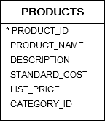
Example of Inline Views
SELECT
*
FROM
(
SELECT
product_id,
product_name,
list_price
FROM
products
ORDER BY
list_price DESC
)
WHERE
ROWNUM <= 10;
Notes:
SELECT * FROM
Products WHERE ROWNUM <= 10
ORDER BY list_price DESC

Slide 26
Views as Authorization Mechanisms
Views can be used to hide certain attributes or tuples from unauthorized users.
User is only allowed to see employee information for employees who work for department 5;
CREATE VIEW DEPT5EMP AS SELECT * FROM EMPLOYEE WHERE Dno = 5;
Notes:
We describe SQL query authorization statements (GRANT and REVOKE) in detail in Chapter 30, when we present database security and authorization mechanisms. Here, we will just give a couple of simple examples to illustrate how views can be used to hide certain attributes or tuples from unauthorized users.
Suppose a certain user is only allowed to see employee information for employees who work for department 5; then we can create the following view DEPT5EMP and grant the user the privilege to query the view but not the base table EMPLOYEE itself. This user will only be able to retrieve employee information for employee tuples whose Dno = 5, and will not be able to see other employee tuples when the view is queried. CREATE VIEW DEPT5EMP AS SELECT * FROM EMPLOYEE WHERE Dno = 5; In a similar manner, a view can restrict a user to only see certain columns; for example, only the first name, last name, and address of an employee may be visible as follows: CREATE VIEW BASIC_EMP_DATA AS SELECT Fname, Lname, Address FROM EMPLOYEE; Thus by creating an appropriate view and granting certain users access to the view and not the base tables, they would be restricted to retrieving only the data specified in the view. Chapter 30 discusses security and authorization in detail, including the GRANT and REVOKE statements of SQL.

Slide 27
Views as Authorization Mechanisms
A view can restrict a user to only see certain columns;
for example, only the first name, last name, and address of an employee may be visible as follows:
CREATE VIEW BASIC_EMP_DATA AS SELECT Fname, Lname, Address FROM EMPLOYEE;

Slide 28
Schema Change Statements in SQL
DROP TABLE table_name;
SQL TRUNCATE TABLE: used to delete the data inside a table, but not the table itself.
TRUNCATE TABLE table_name;
Notes:
In this section, we give an overview of the schema evolution commands available in SQL, which can be used to alter a schema by adding or dropping tables, attributes, constraints, and other schema elements. This can be done while the database is operational and does not require recompilation of the database schema. Certain checks must be done by the DBMS to ensure that the changes do not affect the rest of the database and make it inconsistent

Slide 29
SQL ALTER TABLE Statement
ADD COLUMNS
ALTER TABLE table_name
ADD column_name datatype;
Column Modification
ALTER TABLE table_name
MODIFY column_name datatype;

Slide 30
DROP COLUMNS AND CONSTRAINTS
Drop Column
ALTER TABLE table_name
DROP COLUMN column_name;
Drop constraints
ALTER TABLE table_name
DROP CONSTRAINT Constraint_name;

Slide 31
Add constraints
Unique Constraint
ALTER TABLE table_name
ADD CONSTRAINT constraint_name UNIQUE(column1, column2...);
Check Constraint
ALTER TABLE table_name
ADD CONSTRAINT constraint_name CHECK (CONDITION);
Primary Key
ALTER TABLE table_name
ADD CONSTRAINT constraint_name Primary Key (COL1,COL2,…);
Notes:
Not null constraint must be specified when the column is altered that’s why it is not mentioned over the slide.

Slide 32
Add constraints
FOREIGN KEY Key
ALTER TABLE table_name
ADD CONSTRAINT constraint_name FOREIGN KEY (COLUMN_NAME) REFFERENCES TABLE_NAME (COL1);

Slide 33
Any question????

